Slide 1
API and Python training
Session 6

Slide 2
This session agenda
Functions in programming languages
Functions in Python
Function arguments
Position vs named arguments
Variable scope
Return values
Demo

Slide 3
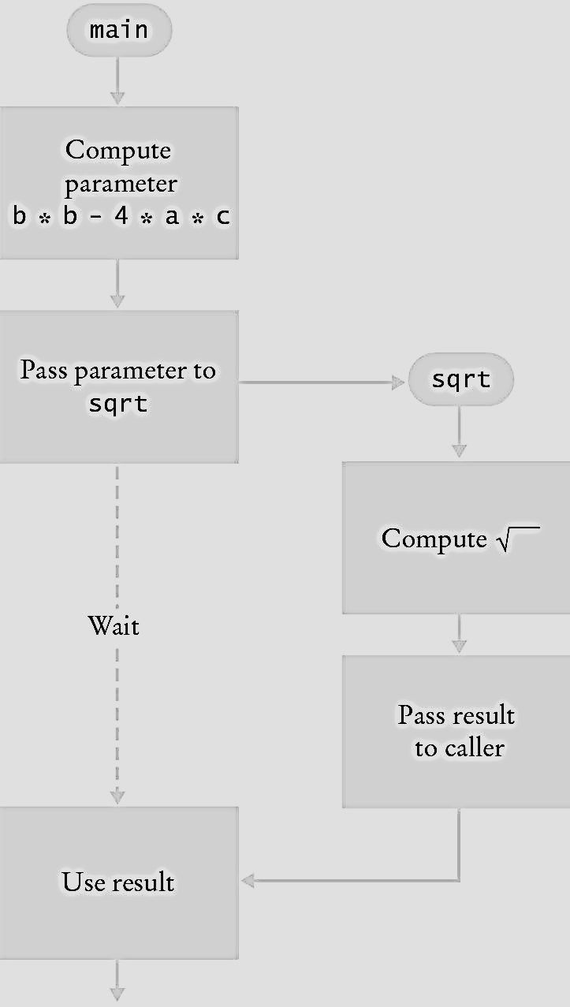
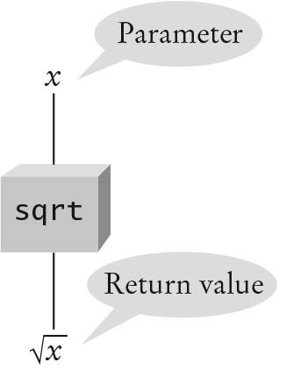
Functions in programming languages
Re-usable block of code which you can run by calling it
Can have arguments (also called parameters)
Can return values – you can use returned value in the main program
When you use the function name in the main program you call it
The function is ‘black box’ – you supply
parameters and get a result, you don’t
need to know the internal function’s
implementation details
https://www.ooportal.com/building-cplus-classes/module2/black-box-principle.php

Slide 4
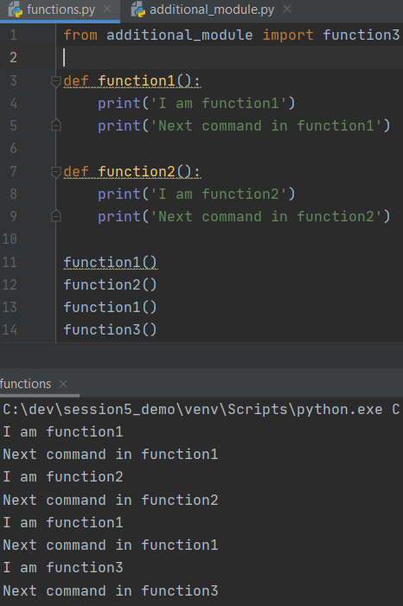
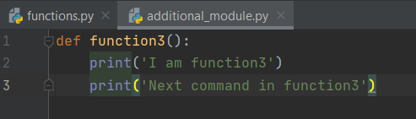
Functions in Python
Syntax:
def <function_name> (parameters):
<block of code>
The block of code within the function has indentation to define where the function starts and ends
Functions can be in the same module as your main program or in different – in this case import it
def function1(): <----------- defining functions
command1
command2
etc
def function2():
command1
command2
etc
function1() <--------- calling functions
function2()
https://www.tutorialspoint.com/python/python_functions.htm

Slide 5
Arguments
When you use arguments/parameters you pass them to the function.
A function may not have any arguments, so just use empty brackets:
def <name>():
Example 1 - The number of arguments you pass from the main program should be the same as defined in the function (there are some special cases though – default argument and arbitrary arguments)
Correct: Incorrect:
def my_func(my_param1, my_param2): def my_func(my_param1, my_param2): <--- two arguments defined
print(my_param1) print(my_param1)
my_func(param1, param2) my_func(param1) <------ but called with only 1 argument
Example 2 - Special case - default arguments
def my_func(my_param1, my_param2 = ‘some default value’):
print(my_param1)
my_func(param1) <------ when calling this function, you can omit default argument my_param2

Slide 6
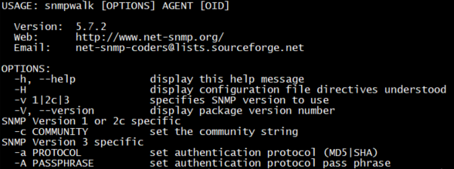
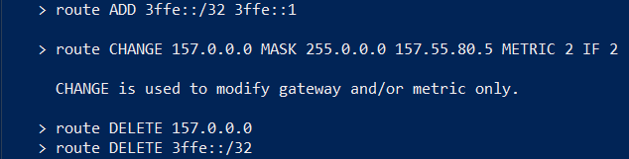
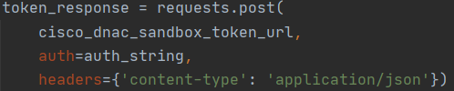
Arguments – positioned vs named
^^^ here we specific parameters (network, mask) by their position
<- here we use parameter names (such as -c -v) in any order
Positional arguments - the order of arguments is important
def divide(a,b,c): def divide(b,a,c):
print(‘dividing:’, a/b/c) print(‘dividing:’, a/b/c)
divide(10,5,2) --> result is 1 divide(10,5,2) --> result is 0.25
Named arguments - the order of arguments can be any, but you need to know variable names in function definition
def divide(a,c,b):
print(‘dividing:’, a/b/c)
divide(b=5, a=10, c=2) --> result is 1
https://stackoverflow.com/questions/9450656/positional-argument-v-s-keyword-argument

Slide 7
Variable scope
Variable names you use in the function definition will become function variables and available for use inside the function
def my_func1(url, token):
print(url, user) <------- user variable is not defined in this function, but url and token is
my_func1(‘https://api-server, ‘abcd’)
Variables defined in functions have function scope – you can’t access it outside the function
def my_func():
my_var = ‘my awesome function variable’
print(my_var) <--------- Incorrect, my_var is defined in function, but this is outside the function, note indentation
You can re-use the same the same variable name in different functions – they are different
def my_func1():
response_code = 200 \
def my_func2(): you can use the same variable name response_code in different functions
response_code = 404 /

Slide 8
Functions returning values
Can return values – you can use returned value in the main program
When you use the function name in the main program you call it
Example 1. No returned value:
def get_sum (var1, var2, var3):
sum = var1 + var3 +var2
print(sum)
get_sum(10,20,30) <--- main program, we call this function
Example 2. With returned value:
def get_sum (var1, var2, var3):
sum = var1 + var2 +var3
return sum <---- 2. after the function completes, this will be the value the caller use in place of the function call
print(get_sum(10, 20, 30)) <--- 1. we call the function from the main program, pass arguments 10,20,30 and print 60
https://www.ooportal.com/building-cplus-classes/module2/black-box-principle.php

Slide 9
Demo

Slide 10
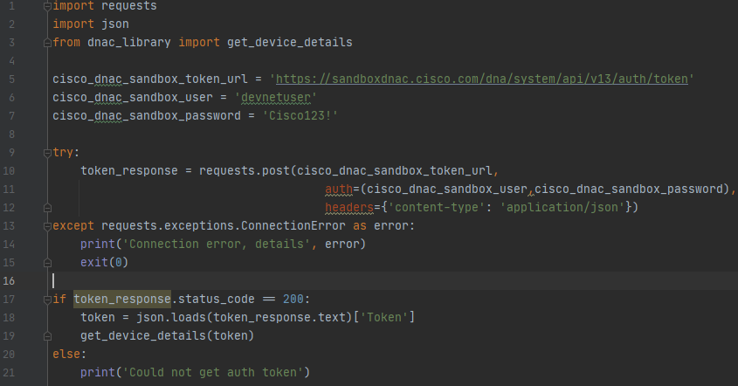
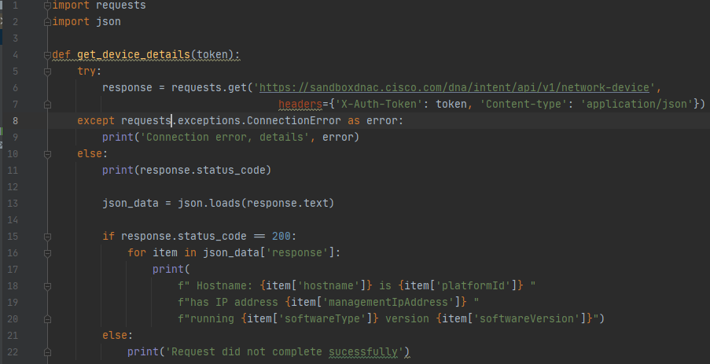
Demo 5 – defining functions, using modules
<--- Main program, note Line 3 – import and Line 19 – calling function get_device_details with argument token
Module is below, Line 4 – definition of function

Slide 11
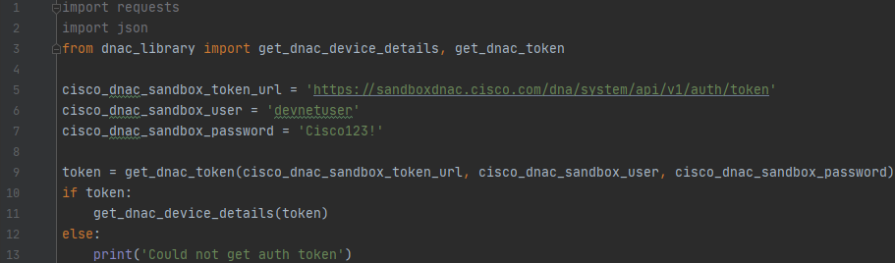
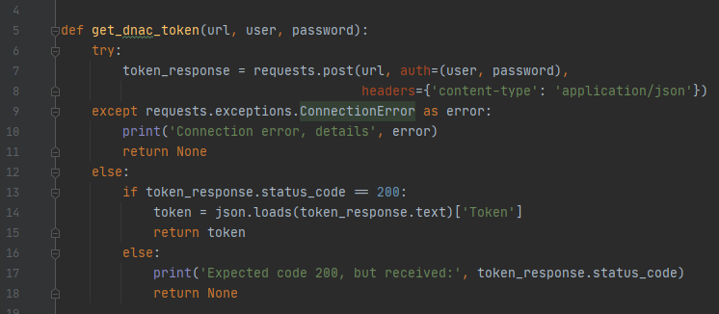
Demo 6 – defining functions with return values
<--- Main program, note Line 1 and 2 – we don’t need import requests and json anymore
Line 3 – import from functions from your module
Below is the function defined in the module
Note Line 15 – we return token only of there were no exceptions and code is OK, other wise we return empty value

Slide 12
Summary and next steps
Summary
Python – functions
Next time
Classes and objects
Using SDKs

